Slide 1

1989: Tim Berners-Lee invents the Web with HTML as its publishing language
Tim Berners-Lee

Slide 2
What is HTML?
Stands for Hyper Text Markup Language
HTML is a computer language at the client’s side, which says to the web browser how to pres.ent the document (web page).

Slide 3
History of HTML
HTML 2.0 is the official standard, which defines those basic functions of HTML, which are meaningfully represented by all Web Browsern.
HTML 3.2 is the most common used standard, which covers those HTML elements, which are supported to a large extent by nearly all Browser versions (starting from 1996/97).
HTML 4.0 is a suggestion of the W3-Consortium, which is at least partly supported by newer Browser versions (starting from 1997/98).
The advancement of HTML starting from 1999/2000 will go into the direction from XHTML.

Slide 4



How the Web Works?
WWW use classical client / server architecture
HTTP is text-based request-response protocol
HTTP
Page request
HTTP
Server response
Server running Web Server Software (IIS, Apache, etc.)
Client running a Web Browser

Slide 5
Creating HTML Pages
An HTML file must have an .htm or .html file extension
HTML files can be created with text editors:
NotePad, NotePad ++, PSPad
Or HTML editors (WYSIWYG Editors):
Microsoft FrontPage
Macromedia Dreamweaver
Netscape Composer
Microsoft Word
Visual Studio

Slide 6
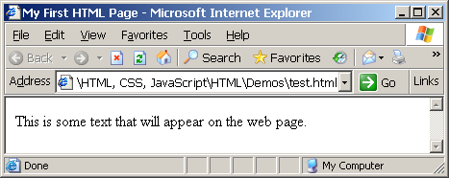
First HTML Page
test.html
<!DOCTYPE HTML>
<html>
<head>
<title>My First HTML Page</title>
</head>
<body>
<p>This is some text...</p>
</body>
</html>

Slide 7
First HTML Page: Tags
<!DOCTYPE HTML>
<html>
<head>
<title>My First HTML Page</title>
</head>
<body>
<p>This is some text...</p>
</body>
</html>
Opening tag
Closing tag
An HTML element consists of an opening tag, a closing tag and the content inside.

Slide 8
First HTML Page: Header
HTML header
<!DOCTYPE HTML>
<html>
<head>
<title>My First HTML Page</title>
</head>
<body>
<p>This is some text...</p>
</body>
</html>

Slide 9
First HTML Page: Body
<!DOCTYPE HTML>
<html>
<head>
<title>My First HTML Page</title>
</head>
<body>
<p>This is some text...</p>
</body>
</html>
HTML body

Slide 10
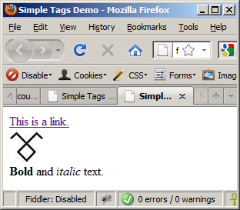
Some Simple Tags – Example (2)
some-tags.html
<!DOCTYPE HTML>
<html>
<head>
<title>Simple Tags Demo</title>
</head>
<body>
<a href="http://www.telerik.com/" title=
"Telerik site">This is a link.</a>
<br />
<img src="logo.gif" alt="logo" />
<br />
<strong>Bold</strong> and <em>italic</em> text.
</body>
</html>

Slide 11
Headings and Paragraphs
Heading Tags (h1 – h6)
Paragraph Tags
Sections: div and span
<h1>Heading 1</h1>
<h2>Sub heading 2</h2>
<h3>Sub heading 3</h3>
<p>This is my first paragraph</p>
<p>This is my second paragraph</p>
<div style="background: skyblue;">
This is a div</div>

Slide 12
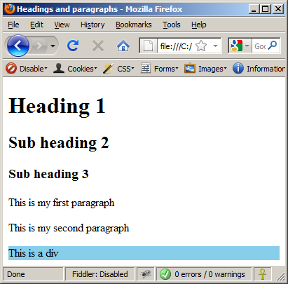
Headings and Paragraphs – Example (2)
headings.html
<!DOCTYPE HTML>
<html>
<head><title>Headings and paragraphs</title></head>
<body>
<h1>Heading 1</h1>
<h2>Sub heading 2</h2>
<h3>Sub heading 3</h3>
<p>This is my first paragraph</p>
<p>This is my second paragraph</p>
<div style="background:skyblue">
This is a div</div>
</body>
</html>

Slide 13

<head> Section: <title> tag
Title should be placed between <head> and </head> tags
Used to specify a title in the window title bar
Search engines and people rely on titles
<title>Telerik Academy – Winter Season 2009/2010 </title>

Slide 14
Comments
Good programming practice to use comments in code to explain code functionality
Comments are not displayed in the final web page
Begin comment with the string <!--
End comment with the string -->

